Slide 1
Realtime Collaboration and Handwriting-to-Text Conversion: Noteable
Jason Brooks, Yale University
Sandhya Kapoor, IBM

Slide 2
Before we begin…
http://goo.gl/forms/CCLC12hl3h

Slide 3

Speaker Backgrounds
Jason Brooks
Third-Year Undergrad, Yale University
Ex-MongoDB Software Engineer
Future Facebook Software Engineer
http://linkedin.com/in/jasonbrooks2
http://github.com/jasonsbrooks
http://twitter.com/jasonsbrooks
Pic Here?
Sandhya Kapoor
Info here

Slide 4
Roadmap
Background and Motivation
What is Notable about Noteable?
Application Walkthrough
Architecture and Technology Stack
Production Environment
Live Demonstration
Q&A

Slide 5
Background & Motivation

Slide 6
Background and Motivation
PennApps Hackathon, Fall 2014
Evolution of note-taking – it’s now a digital experience
Typed notes
Tablets and smart-pens
Two main conclusions:
Digital note-taking is not for everyone
Note-taking is a collaborative experience

Slide 7
The Problems
1) How can we bring the digital note-taking experience to those who prefer handwritten notes?
2) How can we incorporate real-time collaboration with the note-taking experience?

Slide 8
Products on the Market
Two main categories of products:
Searchable picture note applications
Evernote
OneNote
Collaborative note-taking applications
Google Docs
NoteApp

Slide 9
What is Notable about Noteable?

Slide 10
What is Noteable?
A method for converting handwritten notes into fully digital, editable documents
Provides on-the-fly collaboration by providing an instant link for a newly created note sheet
Have a concept that you want to look up later, or an equation that you would like to simply learn more about?
“Augmented Reality” extension to the note-taking experience
Noteable is a cloud-based solution that reinvents the note-taking experience by fully digitizing handwritten notes and creating a medium for more interactive notes.

Slide 11
Two Methods
Existing Hand-Written Notes
Start by taking a new or uploading an existing picture with our iPhone app
In real time, the data will be converted to fully editable and se
On-the-fly collaborative note-taking
Sign into the Noteable application
Click to create a new document
Send the short link to collaborators to open the document instantly
Input a list of email addresses to notify collaborators of a new document

Slide 12
Noteable’s Benefit
Guaranteed scalability with Bluemix
No other application provides fuses the two core problems
Runnable across (nearly) all platforms
On-the-fly sharing

Slide 13
Walkthrough

Slide 14
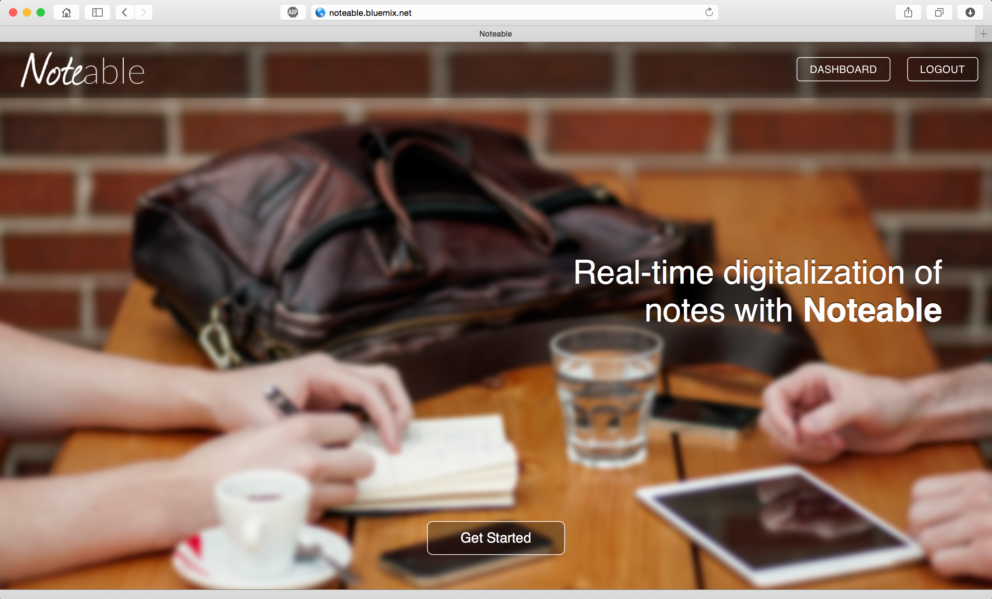
Web Application

Slide 15
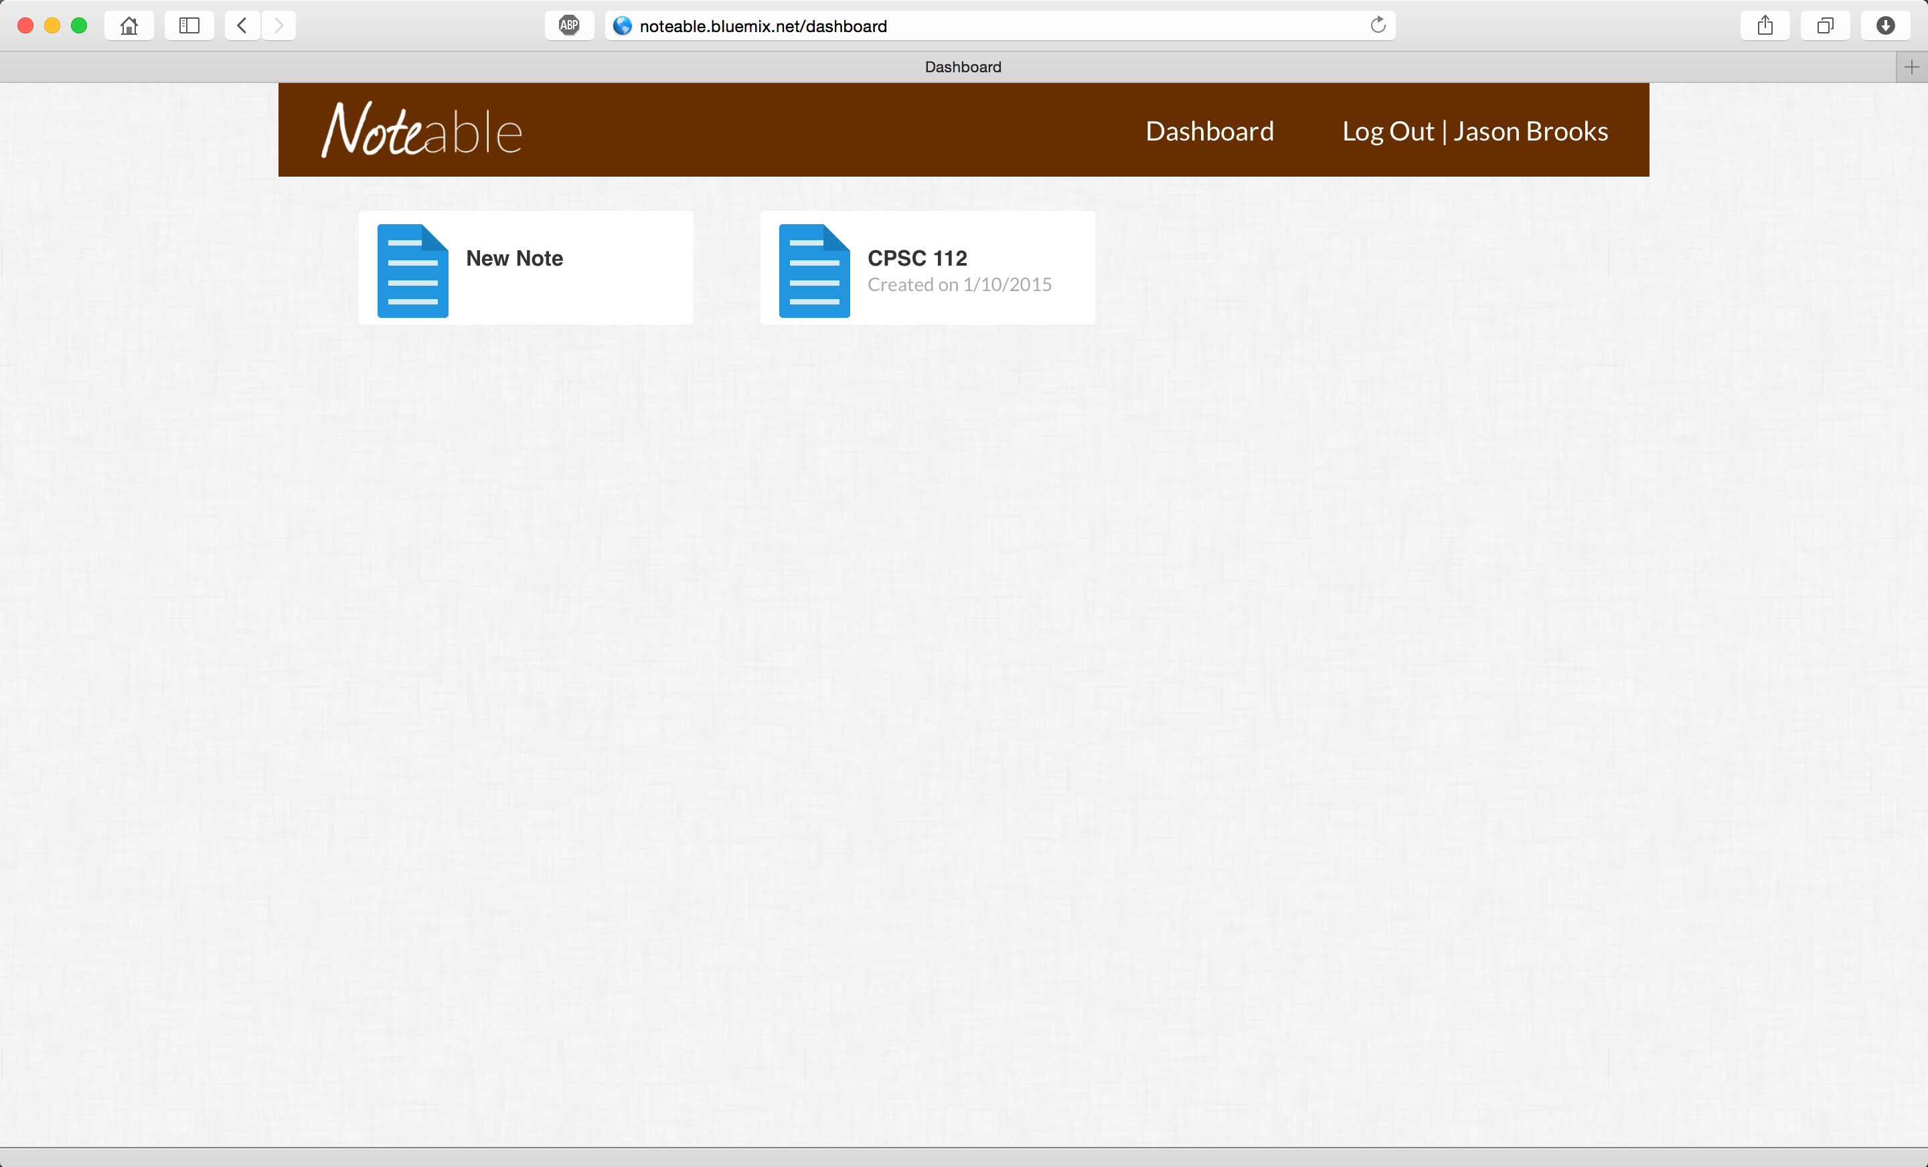
Web Application

Slide 16
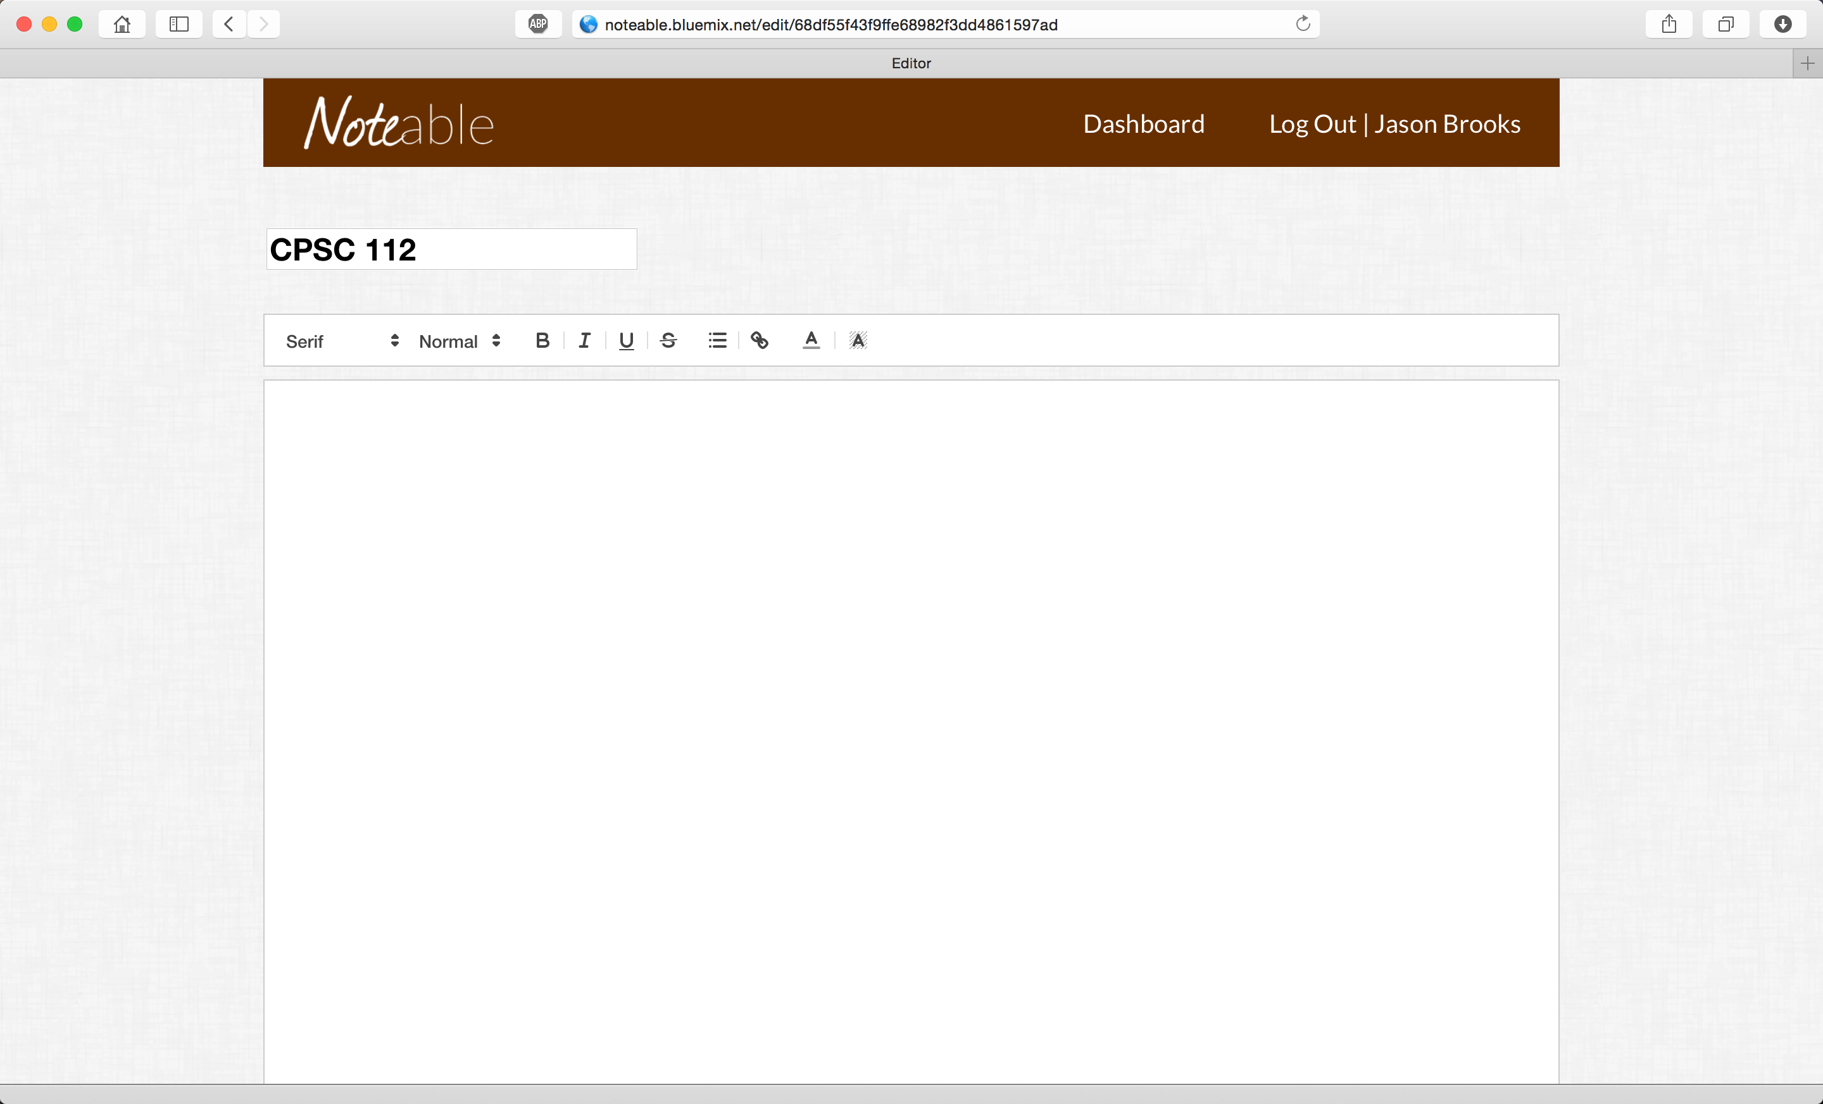
Web Application

Slide 17
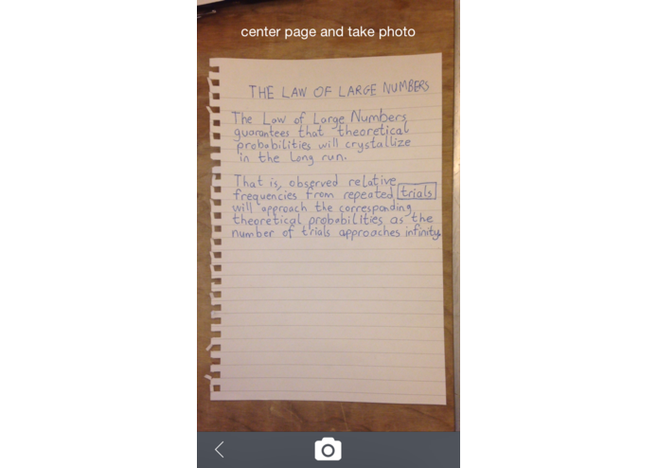
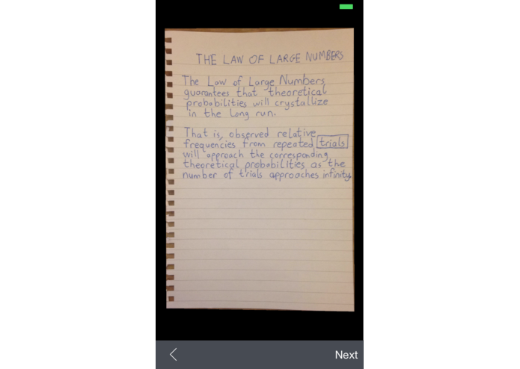
iPhone Application

Slide 18
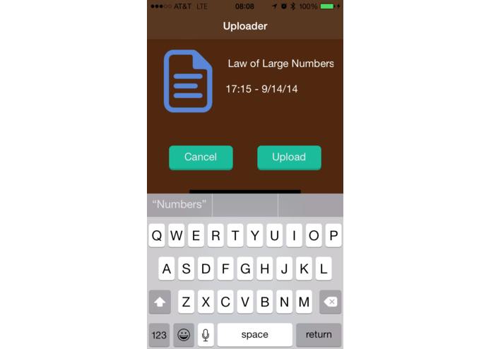
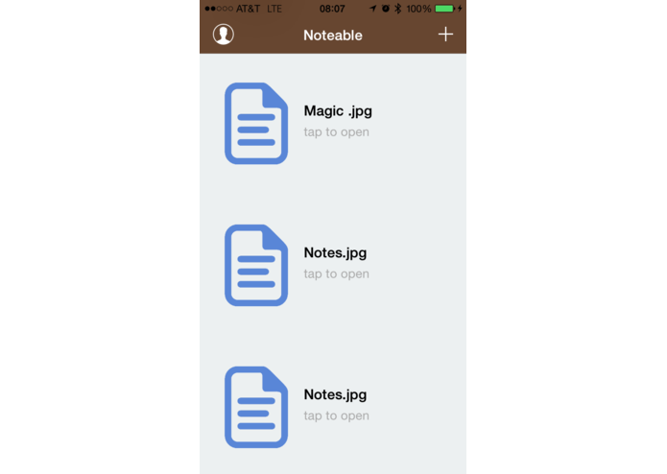
iPhone Application

Slide 19
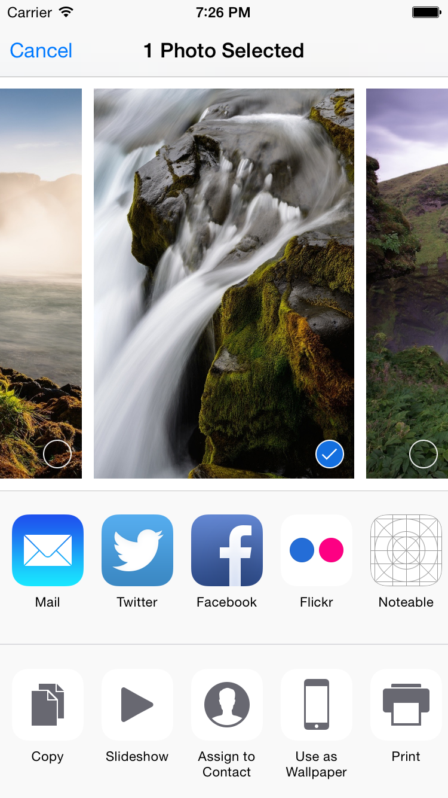

iPhone Application

Slide 20
Architecture and Technology Stack

Slide 21
Overview of Technology
Web Side:
“CANE” stack – Cloudant, Angular, Node.js, Express
Custom Python pipeline for image processing
Operational Transformation (OT) implementation for collaborative editing with ShareJS and Rich-Text OTType
iOS Side:
Objective-C application built in Xcode
iOS extension for uploading capability

Slide 22
Data Pipeline
node.js web application
Cloudant
iOS Application

Slide 23
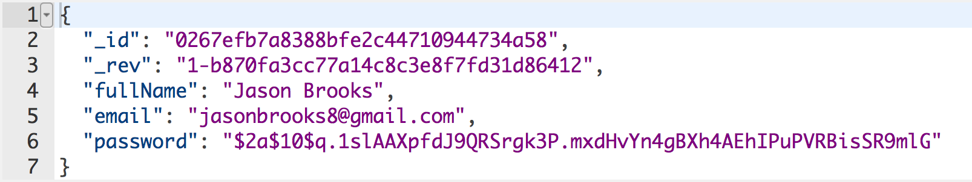
User Objects with Cloudant

Slide 24
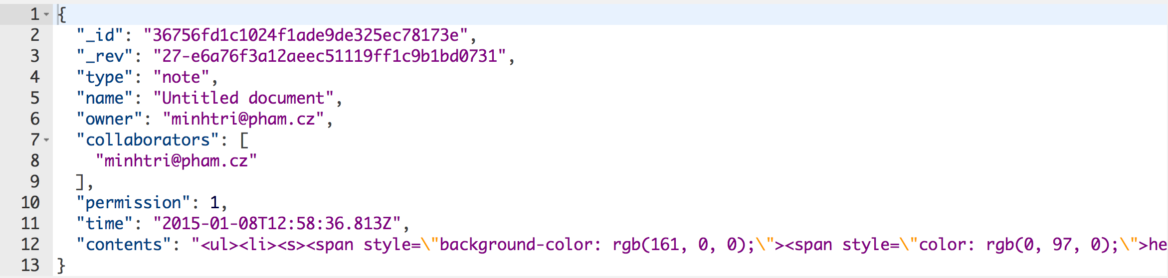
Note Objects with Cloudant

Slide 25
Collaborative Editing
node.js Server
Web Front-End
ShareJS
Sockets.IO
LiveDB
QuillJS

Slide 26
Production Environment

Slide 27
Production Environment
App lives on IBM Bluemix
Ensures scalability that other solutions do not have
Utilizes the auto scaling add-on
Configured that so if the usage goes above a certain amount, then another instance will be spawned
Guaranteed reliability of application
Linux containers in which the app runs detects when the app goes down, and another instance is created

Slide 28
DevOps Tools
Git integration with IBM Bluemix for easy change pushing
Default node.js bluemix kit
Intuitive logging on Bluemix for error debugging
Easy integration and real-time data viewing with Cloudant

Slide 29
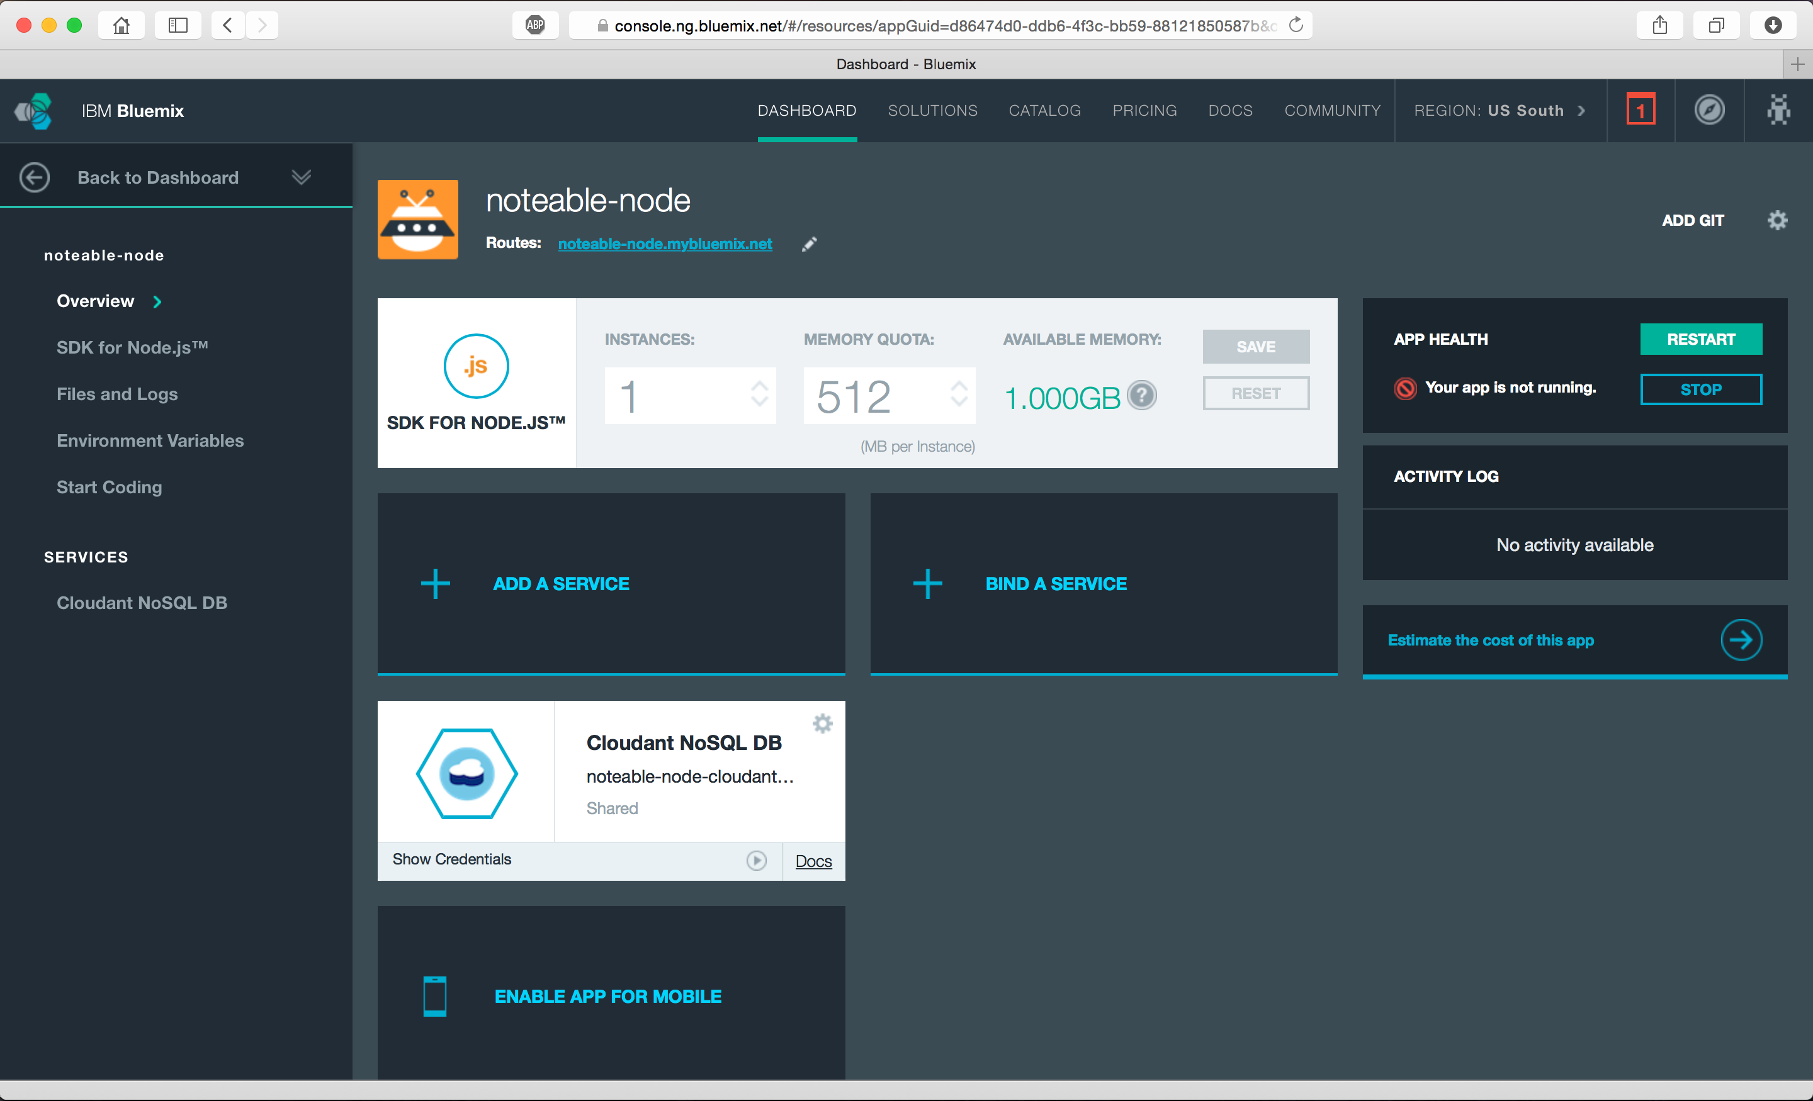
Bluemix Environment

Slide 30
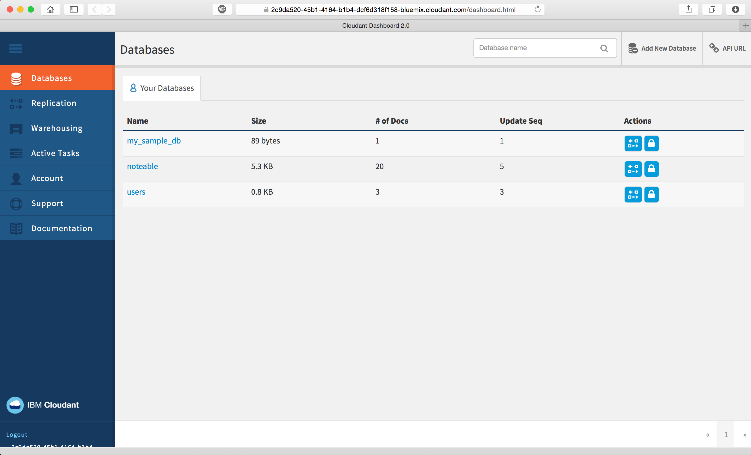
Cloudant Environment

Slide 31
Live Demonstration

Slide 32
Q&A

Slide 33
Notices and Disclaimers
Copyright © 2015 by International Business Machines Corporation (IBM). No part of this document may be reproduced or transmitted in any form without written permission from IBM.
U.S. Government Users Restricted Rights - Use, duplication or disclosure restricted by GSA ADP Schedule Contract with IBM.
Information in these presentations (including information relating to products that have not yet been announced by IBM) has been reviewed for accuracy as of the date of initial publication and could include unintentional technical or typographical errors. IBM shall have no responsibility to update this information. THIS document is distributed "AS IS" without any warranty, either express or implied. In no event shall IBM be liable for any damage arising from the use of this information, including but not limited to, loss of data, business interruption, loss of profit or loss of opportunity. IBM products and services are warranted according to the terms and conditions of the agreements under which they are provided.
Any statements regarding IBM's future direction, intent or product plans are subject to change or withdrawal without notice.
Performance data contained herein was generally obtained in a controlled, isolated environments. Customer examples are presented as illustrations of how those customers have used IBM products and the results they may have achieved. Actual performance, cost, savings or other results in other operating environments may vary.
References in this document to IBM products, programs, or services does not imply that IBM intends to make such products, programs or services available in all countries in which IBM operates or does business.
Workshops, sessions and associated materials may have been prepared by independent session speakers, and do not necessarily reflect the views of IBM. All materials and discussions are provided for informational purposes only, and are neither intended to, nor shall constitute legal or other guidance or advice to any individual participant or their specific situation.
It is the customer’s responsibility to insure its own compliance with legal requirements and to obtain advice of competent legal counsel as to the identification and interpretation of any relevant laws and regulatory requirements that may affect the customer’s business and any actions the customer may need to take to comply with such laws. IBM does not provide legal advice or represent or warrant that its services or products will ensure that the customer is in compliance with any law.

Slide 34
Notices and Disclaimers (con’t)
Information concerning non-IBM products was obtained from the suppliers of those products, their published announcements or other publicly available sources. IBM has not tested those products in connection with this publication and cannot confirm the accuracy of performance, compatibility or any other claims related to non-IBM products. Questions on the capabilities of non-IBM products should be addressed to the suppliers of those products. IBM does not warrant the quality of any third-party products, or the ability of any such third-party products to interoperate with IBM’s products. IBM expressly disclaims all warranties, expressed or implied, including but not limited to, the implied warranties of merchantability and fitness for a particular purpose.
The provision of the information contained herein is not intended to, and does not, grant any right or license under any IBM patents, copyrights, trademarks or other intellectual property right.
IBM, the IBM logo, ibm.com, Bluemix, Blueworks Live, CICS, Clearcase, DOORS®, Enterprise Document Management System™, Global Business Services ®, Global Technology Services ®, Information on Demand, ILOG, Maximo®, MQIntegrator®, MQSeries®, Netcool®, OMEGAMON, OpenPower, PureAnalytics™, PureApplication®, pureCluster™, PureCoverage®, PureData®, PureExperience®, PureFlex®, pureQuery®, pureScale®, PureSystems®, QRadar®, Rational®, Rhapsody®, SoDA, SPSS, StoredIQ, Tivoli®, Trusteer®, urban{code}®, Watson, WebSphere®, Worklight®, X-Force® and System z® Z/OS, are trademarks of International Business Machines Corporation, registered in many jurisdictions worldwide. Other product and service names might be trademarks of IBM or other companies. A current list of IBM trademarks is available on the Web at "Copyright and trademark information" at: www.ibm.com/legal/copytrade.shtml.

Slide 35
Thank You
Your Feedback is Important!
Access the InterConnect 2015 Conference CONNECT Attendee Portal to complete your session surveys from your smartphone,
laptop or conference kiosk.

